Slide 1
Machine Learning for Joint Sensing and Communication in Future Millimeter Wave IEEE 802.11 WLANs
Steve Blandino, Tanguy Ropitault, Raied Caromi, Nada Golmie

Slide 2
Outline
Communication and sensing in mm-wave band.
Turning Wi-Fi devices into motion sensors.
The NIST Q-D framework
ITU AI/ML challenge 2021: sensing with mm-wave communications and ML.

Slide 3
Communication and sensing in mm-wave band

Slide 4


Old paradigm: Communication OR sensing
6 GHz
24 GHz
58 GHz
64 GHz
100 GHz
mm-wave
Communication
Sensing
Multi-Gb/s wireless communications.
Cm level sensing resolution.

Slide 5
New paradigm: Communication AND sensing
6 GHz
24 GHz
58 GHz
64 GHz
100 GHz
mm-wave
Communication
Sensing
Multi-Gb/s wireless communications.
Cm level sensing resolution.
Communication waveforms to enable sensing
Radar waveforms to enable communications

Slide 6
Communication waveforms to enable sensing
6 GHz
24 GHz
58 GHz
64 GHz
100 GHz
mm-wave
Communication
Sensing
Multi-Gb/s wireless communications.
Cm level sensing resolution.
Communication waveforms to enable sensing
Radar waveforms to enable communications

Slide 7
Turning Wi-Fi devices into motion sensors

Slide 8
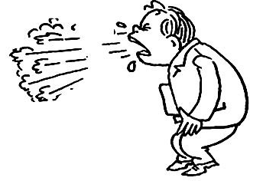
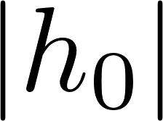
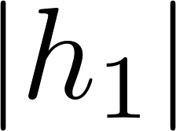

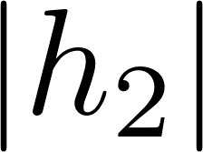
Turn Wi-Fi devices into motion sensors
Ubiquitous WiFi devices:
Reuse communication devices and protocols to perform sensing.
Sensing can be performed by tracking changes on a wireless channel through the reception of multiple packets over time.
Time-variations of the channel can be analyzed using signal processing, ML/AI or both.
Droplets
Transmit signal
Receive signal in monostatic mode
Device 1
Receive signal in bistatic mode
Device 2
https://mentor.ieee.org/802.11/dcn/20/11-20-1640-00-00bf-wlan-sensing-usage-model-sneeze-sensing.pptx

Slide 9
IEEE 802.11bf: WLAN Sensing
IEEE 802.11bf started in Sep/20
Sub 6GHz and mm-wave.
In mm-wave: use IEEE 802.11ay as a “toolbox” to be used for sensing
Re-exploit frame structure to enable sensing
Preamble provides sequences repetition to enable radar-like processing
It will be extended with dedicated procedures for sensing.
Use cases:
Presence detection, counting number of people, track people location, gesture detection recognition, person identification, vital sign monitoring, in car sensing, fast detection of sleeping drivers, etc.
https://mentor.ieee.org/802.11/documents?is_dcn=DCN%2C%20Title%2C%20Author%20or%20Affiliation&is_group=00bf

Slide 10
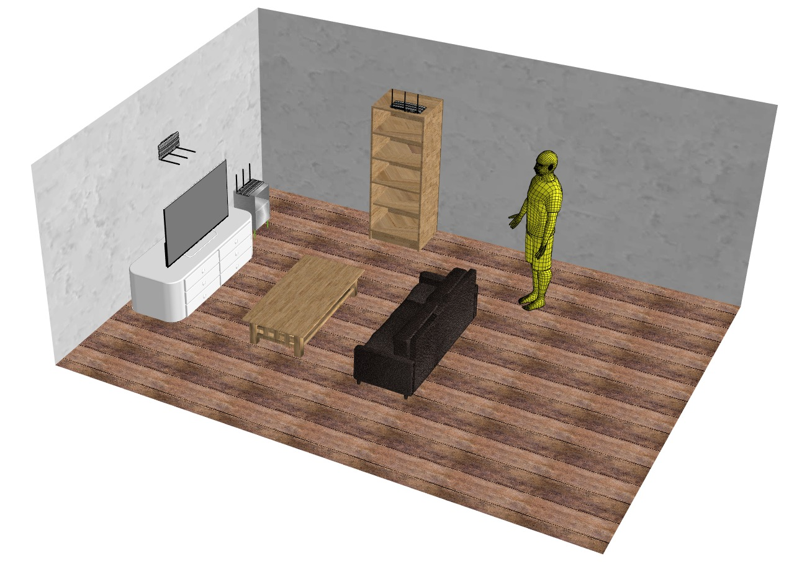
Use case: sensing human presence
Multiple mm-wave WLAN devices working as multi-static radar.
Multiple people moving in an indoor environment.
Indoor sensing:
Presence detection, number of people in the room, localization of active people.
Application example: audio with user tracking
Tracking people in a room and pointing the sound of an audio system at them.
WLAN Devices
Moving target

Slide 11
The NIST Q-D framework

Slide 12
The NIST Q-D framework
NIST Quasi-Deterministic (Q-D) framework
Develop simulation models to evaluate IEEE 802.11ad/ay end-to-end (communication) performance with high-fidelity channel, antenna model and system-level protocols.
Extend the NIST Q-D framework to evaluate IEEE 802.11bf end-to-end performance (communication and sensing) with high-fidelity channel, antenna model and system-level protocols.
5 software packages (https://github.com/wigig-tools)
NIST Q-D Channel Realization Software
NIST 802.11ay PHY
ns-3 802.11ad/ay with Q-D channel
Codebook Generator
NIST Q-D Interpreter
Measurements
Channel
System-Level
Antenna Model
NIST Q-D Channel Realization software*
ns-3 802.11ad/ay
with Q-D channel**
Codebook Generator*
PHY
Interpretation
NIST 802.11ay PHY*
NIST
Q-D Interpreter***
* Matlab ** C++ *** Python

Slide 13
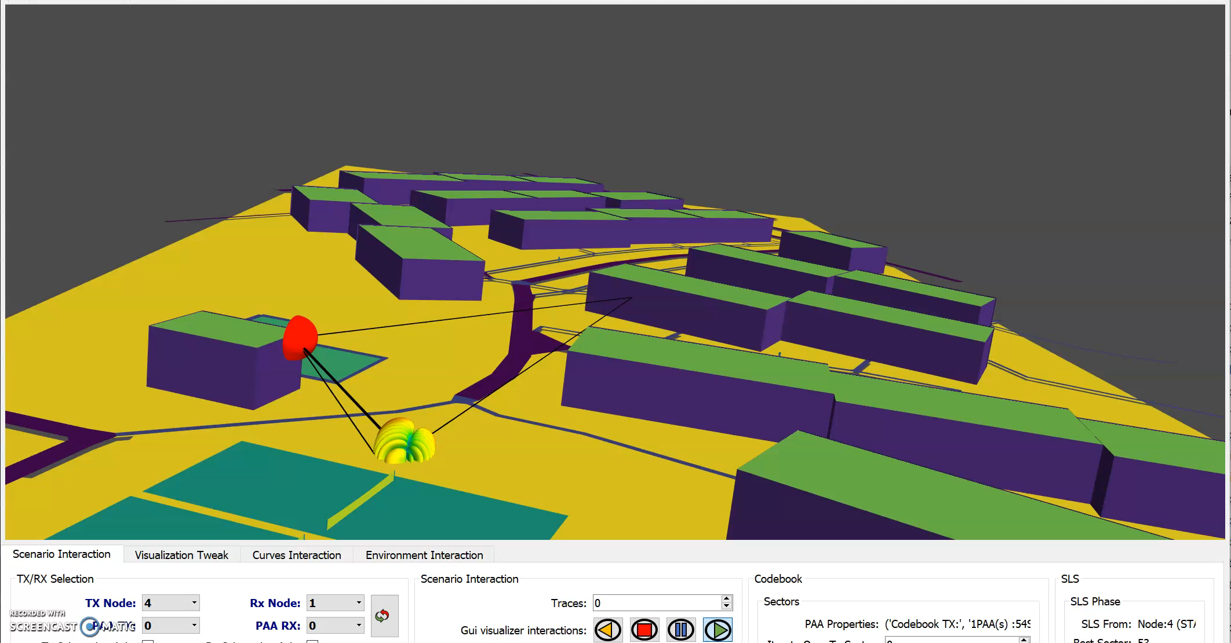
The NIST Q-D framework
Measurements
Channel
System-Level
Antenna Model
NIST Q-D Channel Realization software*
ns-3 802.11ad/ay
with Q-D channel**
Codebook Generator*
PHY
Interpretation
NIST 802.11ay PHY*
NIST
Q-D Interpreter***

Slide 14
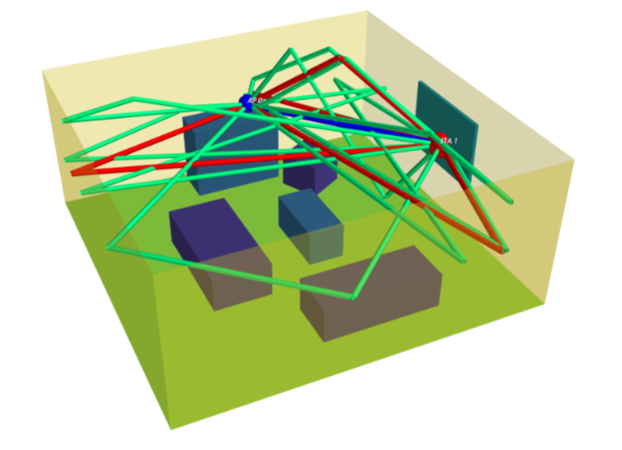
The NIST Q-D Channel realization software
The NIST Q-D Channel Realization software uses the Q-D methodology to generate Multi-Paths Components (MPCs)
Specular rays: Deterministic approach – Ray tracing (method of images)
Diffuse components: Stochastic approach using a material library (reflectivity, number of pre-post cursors, etc.)
Channel model for sensing should include:
Target(s) to be sensed
Location, trajectory, etc.
IEEE Living Room Scenario

Slide 15
Target properties
Spatial consistency:
Both large-scale and small-scale parameters vary with the position of the WLAN nodes, the targets and the environment.
Temporal consistency:
Large-scale and small-scale parameters are correlated over time when WLAN nodes or targets move.
Complex targets:
Objects with multiple scattering points: the overall scattering is the sum of all scattering mechanisms from each individual scattering point.

Slide 16
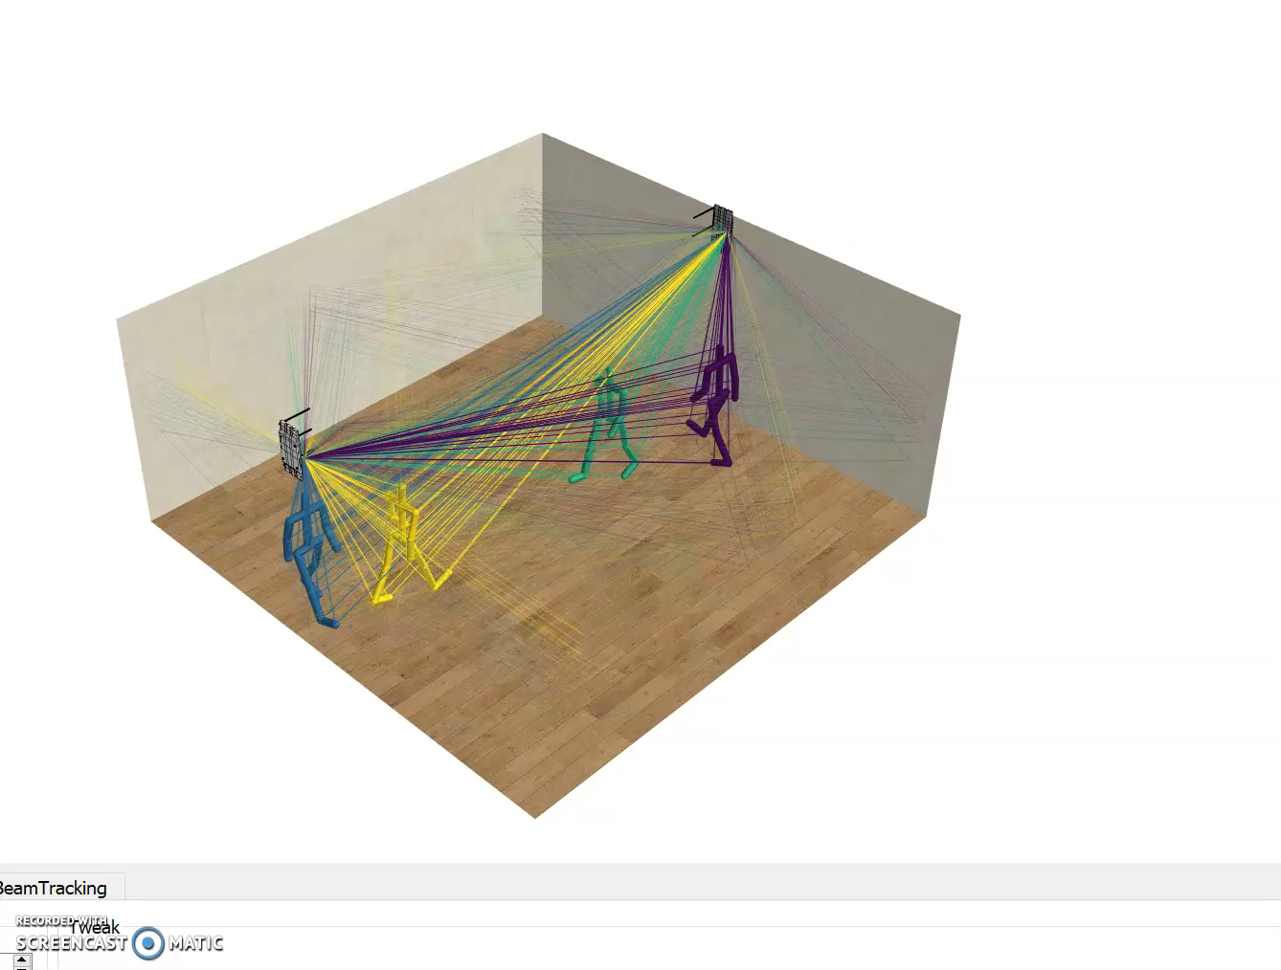
Complex targets: example human motion
Human micro-doppler signature reflects human motion.
Human walking is a periodic movement.
Human body is highly coordinated: when moving, body parts movements are highly correlated.
Scattering signal from human motion can be modeled as a cluster of scattering points.

Slide 17
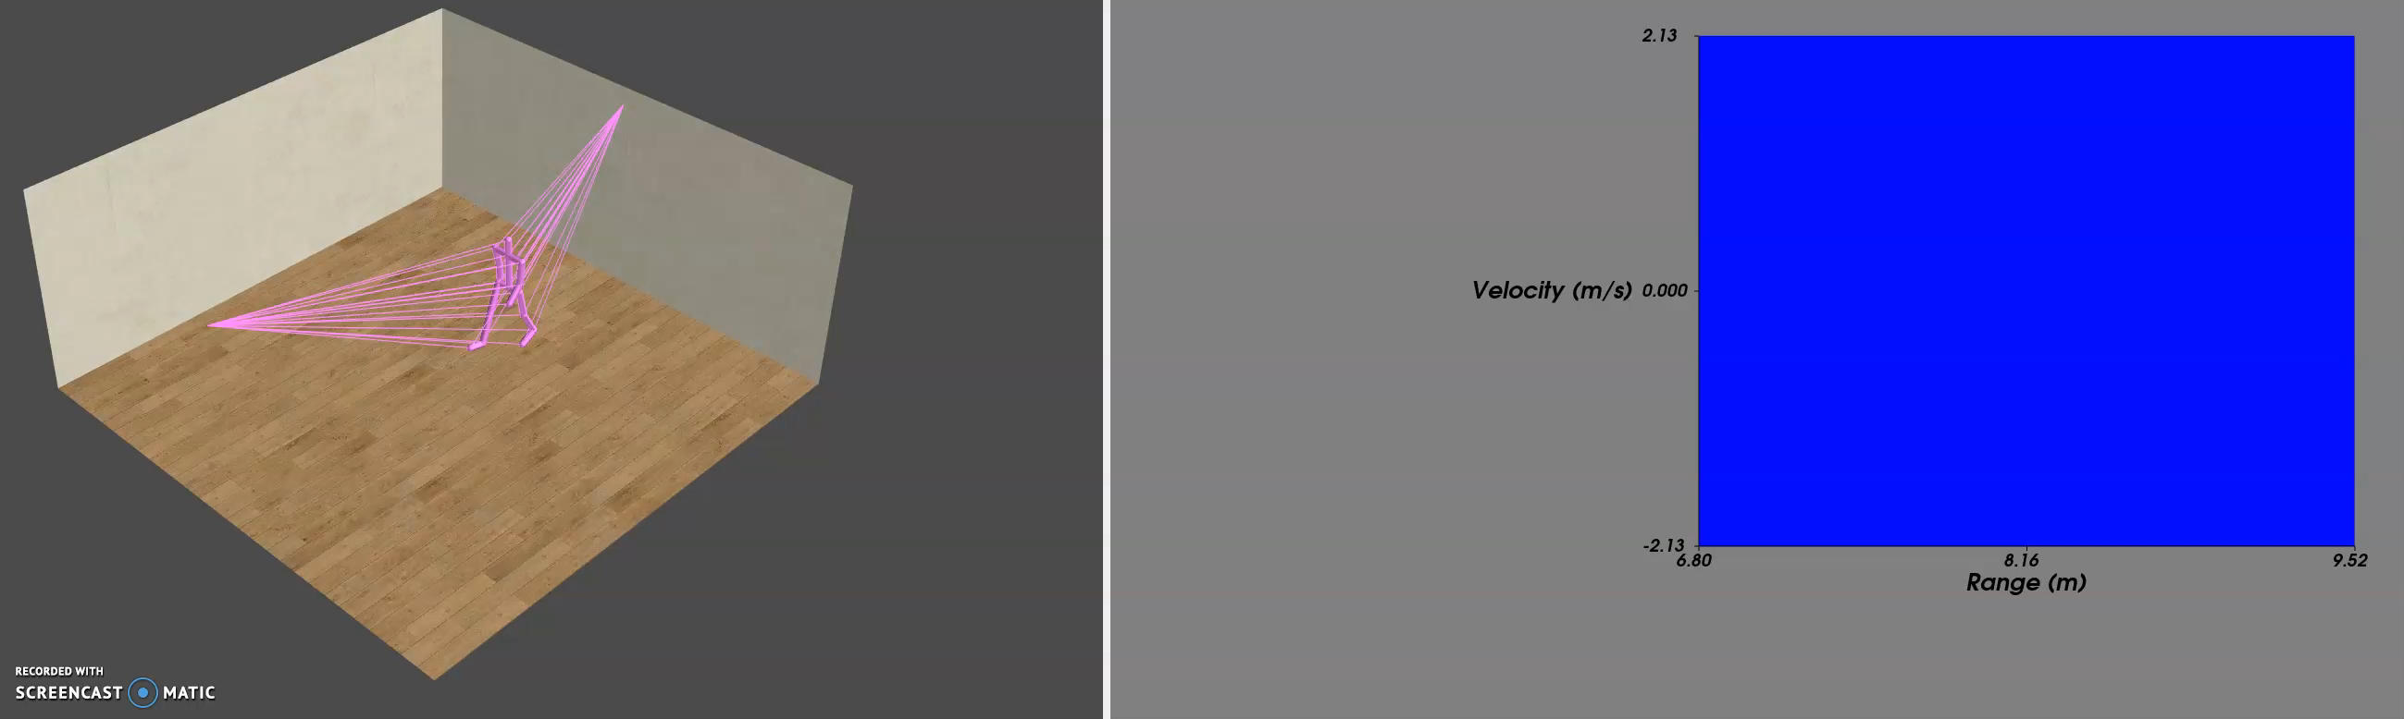
Channel model analysis: human motion scenario
Living room environment (7m×7m×3m).
Bi-static system: 1 TX (-3.9m, 0m, 2.8m) and 1 RX (3m, 0m, 2.8m).
1 target:
17 centers of scattering (joints).
Human walking at ~1m/s.
Channel realization rate: 1ms.
Frequency: 60GHz

Slide 18
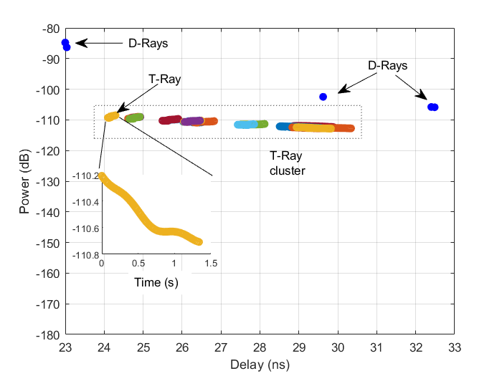
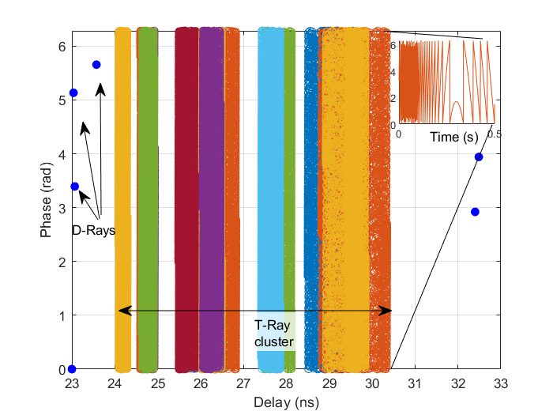
Ray tracing results: double directional impulse response
The model captures both the static environment (D-Rays) and the dynamics of the target moving over time (T-Rays).

Slide 19
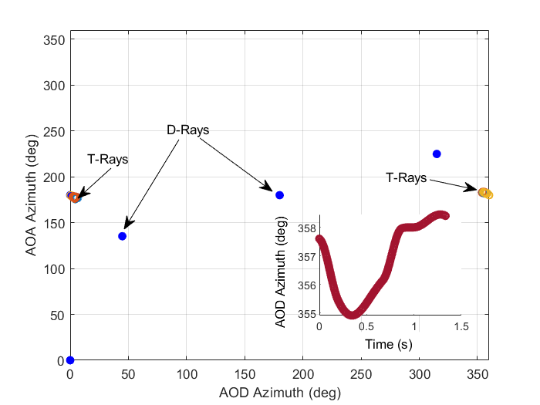
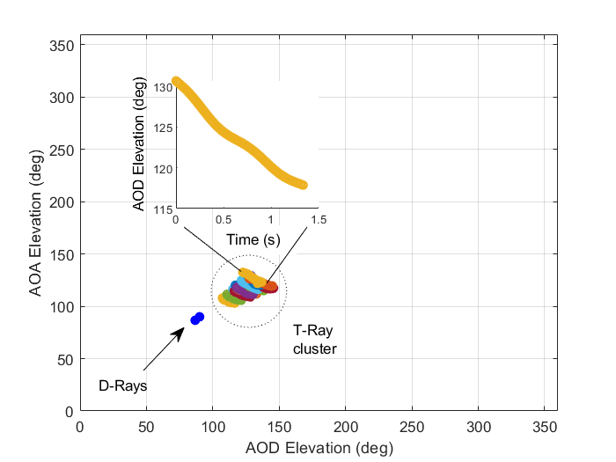
Ray tracing results: double directional impulse response
The model captures both the static environment (D-Rays) and the dynamics of the target moving over time (T-Rays).

Slide 20
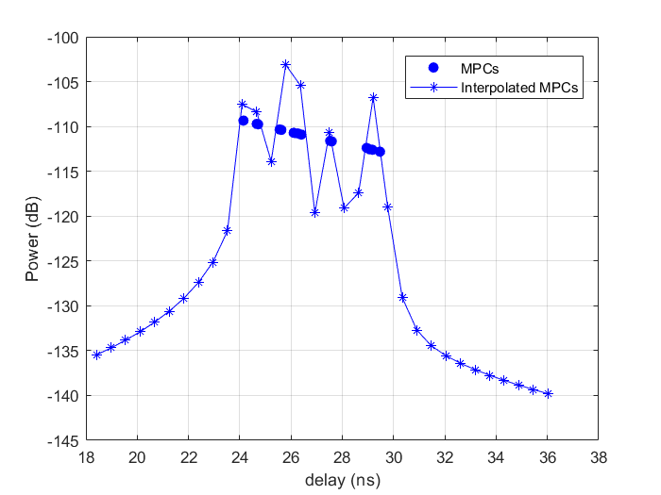
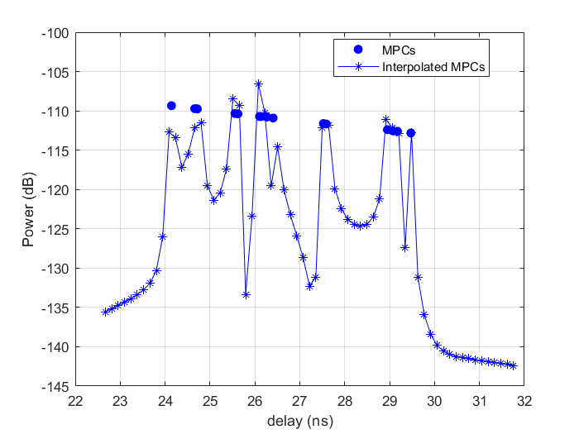
Effect of ideal band limitation
Multipath components (MPCs) are merged in fewer taps.
Resample @ 1.76GHz
Resample @ 7.04GHz

Slide 21

ITU AI/ML 5G challenge 2.0: Where’s waldo?

Slide 22
Sensing with mm-wave communications and ML
Two MIMO WLAN Access Points working as a bi-static radar.
Multiple dynamic people in an indoor environment.
WALDO (Wireless Artificial intelligence Location DetectiOn): sensing using mmWave communications and ML.
Presence detection.
Target localization.
WLAN Access Point
WLAN Access Point
Moving target

Slide 23
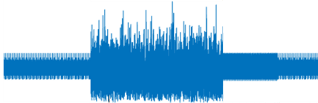
Communication and sensing using signal processing
IEEE 802.11ay waveform
Waveform generation and transmitter
Channel
Receiver
Channel estimation
Range doppler map
Detector
Presence detection, counting number of people ..
Receiver Signal Processing

Slide 24
Communication and sensing using signal processing
IEEE 802.11ay waveform
Waveform generation and transmitter
Channel
Receiver
Channel estimation
Range doppler map
Detector
Presence detection, counting number of people ..
Receiver Signal Processing
Channel model with spatial and temporal consistency

Slide 25
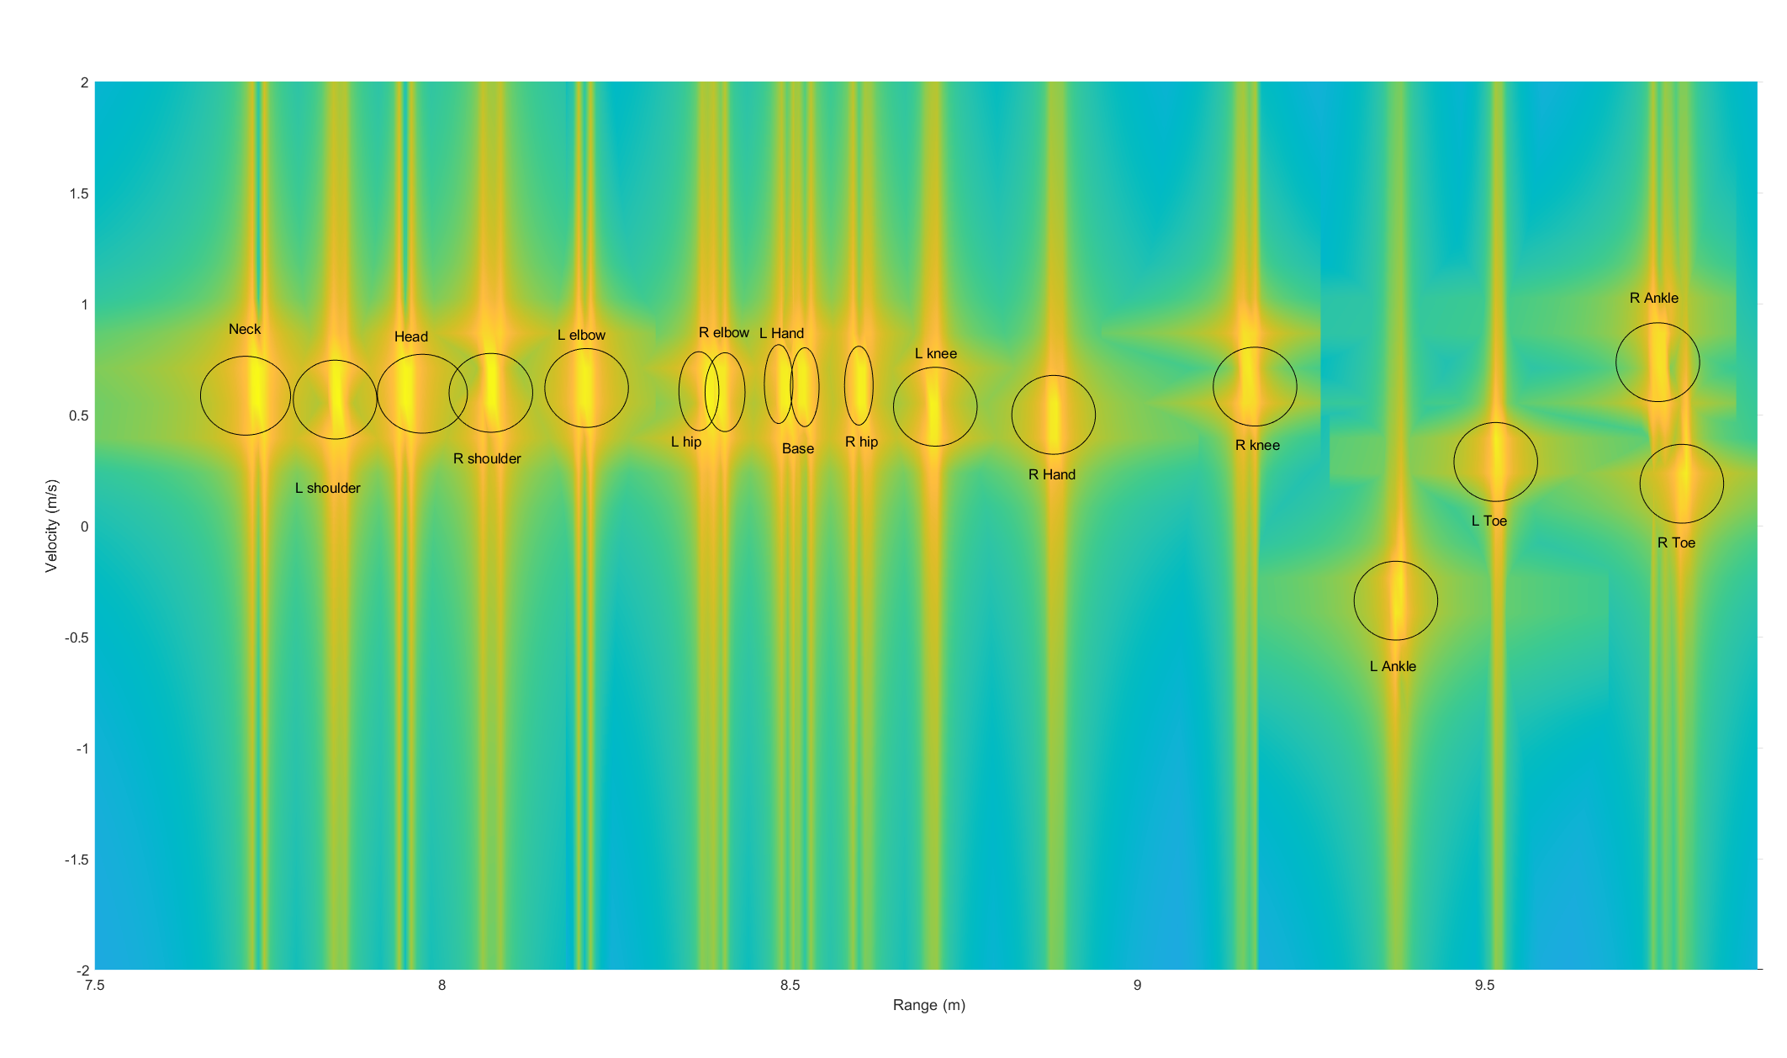
Communication and sensing using signal processing
IEEE 802.11ay waveform
Channel estimation
Waveform generation and transmitter
Channel
Receiver
Channel estimation
Range doppler map
Detector
Presence detection, counting number of people ..
Receiver Signal Processing
Range-Doppler map
Channel model with spatial and temporal consistency

Slide 26
Communication and sensing using ML
IEEE 802.11ay waveform
AI/ML: WALDO
Waveform generation and transmitter
Channel
Receiver
Presence detection, counting number of people ..
Channel model with spatial and temporal consistency

Slide 27

Where’s WALDO?
A
D
G
B
E
H
C
F
I

Slide 28
WALDO: we finally found you!
A
D
G
Sector | #people
A | 0
B | 0
C | 0
D | 0
E | 0
F | 0
G | 1
H | 0
I | 0
B
E
H
C
F
I

Slide 29

Where’s WALDO?
A
D
G
B
E
H
C
F
I

Slide 30
WALDO: we finally found you!
A
D
G
Sector | #people
A | 0
B | 0
C | 1
D | 0
E | 0
F | 0
G | 1
H | 0
I | 0
B
E
H
C
F
I

Slide 31






Challenge dataset
Q-D Input
Ground Truth
Number of targets
Sector of each target
Static Environment Geometry
2 Static WLAN Sensing Nodes
4 Tx and 4 Rx antennas
Targets: Mobility for every joint
Random number of Targets (1-8)
Each target as a random position, trajectory and velocity
128 channel realizations per scenario (1ms between each realization), 15k scenarios
NIST Q-D Channel Realization software
Sector | #people
A | 1
B | 0
C | 1
.txt
Q-D Output
.json
MPCs (AOA, AOD, Phase, delay and amplitude)
Challenge evaluation
Channel resample at 1.76GHz
Sector | #people
A | 1
B | 0
C | 0
Noise
.txt
Waveform generation:
IEEE 802.11ay MIMO-CEF
Channel
Received Signal
Number of targets
Sector of each target
AI/ML
.mat
Provided
Available but not required to solve the challenge
Not provided (Challenge)

Slide 32
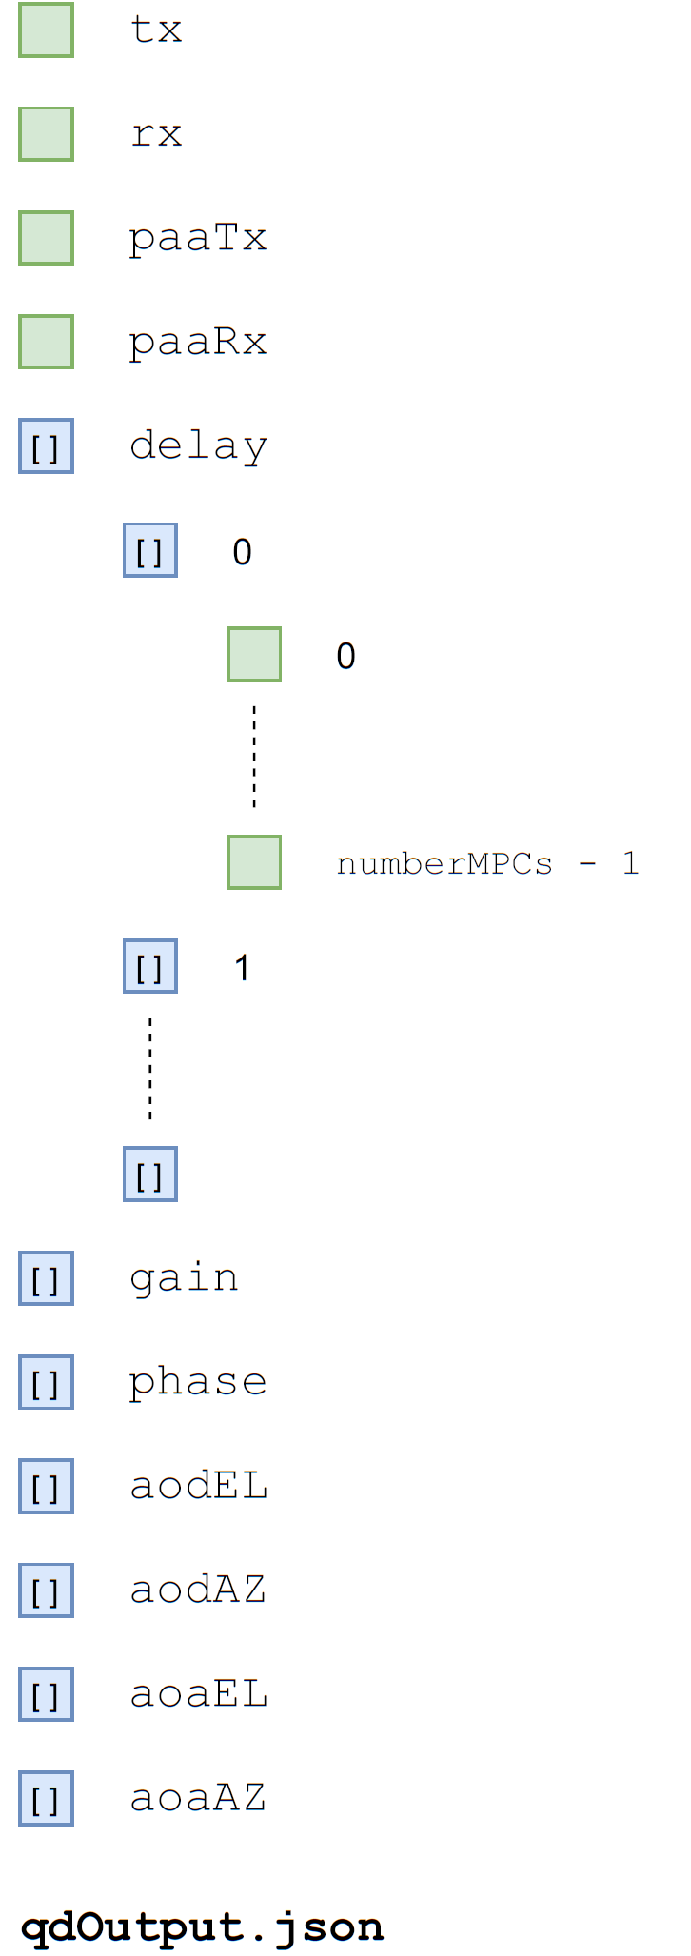
Challenge dataset: channel
Q-D channel output (qdChannel/qdOutput#)
Tx index (index from 0)
Rx index (index from 0)
Antenna tx index (index from 0)
Antenna rx index (index from 0)
Double directional impulse response
Delay (s)
Gain (dB)
Phase (rad)
Angle of arrival/departure, azimuth, elevation (Deg)
Available but not required to solve the challenge

Slide 33
Challenge dataset: get receive signal
Matlab script can be used to generate ML input (receivedSignalGeneration/scriptGenerateRxSig.m) :
Generate pilot sequence.
Load channel (qdOutput.json), resample at 1.76GHz
Transmit pilots on channel.
Add noise
Save received signals in .mat files
Available but not required to solve the challenge

Slide 34
Received signal
rxSigCh#.mat file (dataset/snr#/rxSigCh#.mat) :
Received signal is a 3D matrix Ns × Na × Nc
Ns: number of received samples
Na: number of antennas (4)
Nc: number of channels (128)
Provided

Slide 35
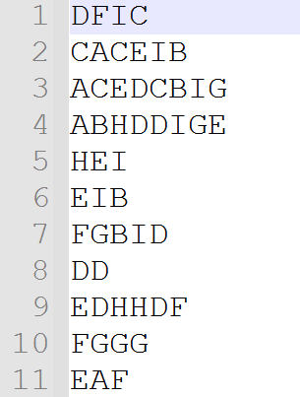
Challenge dataset: ground truth
Counting: 8 people
.txt file (mlOuput/groundTruth.txt)
Each row is a vector of chars. Each entry corresponds to a target position.
The length of the vector is the number of people.
Localization
Sector | #people
A | 1
B | 1
C | 0
D | 2
E | 1
F | 0
G | 1
H | 1
I | 1
Provided

Slide 36
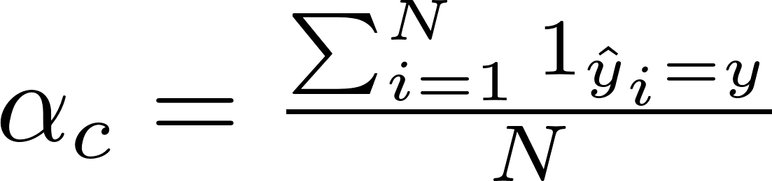

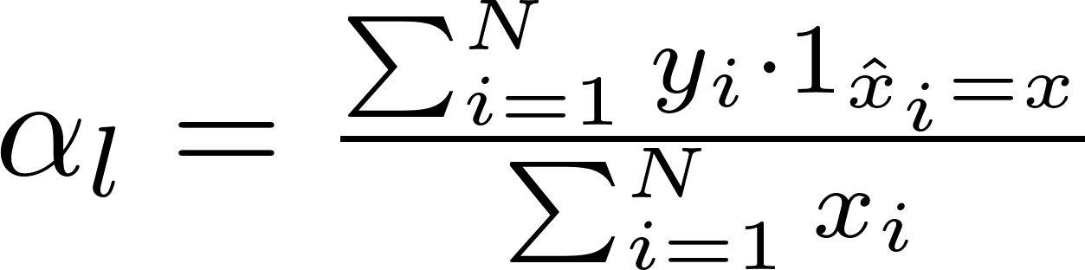
Challenge evaluation
Number of targets
Sector of each target
Counting error:
Accuracy in counting the total number of people present in the room.
Localization error:
Accuracy in counting the number of people present in each sector.
Sector | #people
A | 1
B | 0
C | 1
.txt
Challenge evaluation
Sector | #people
A | 1
B | 0
C | 0
.txt
Number of targets
Sector of each target
Provided

Slide 37

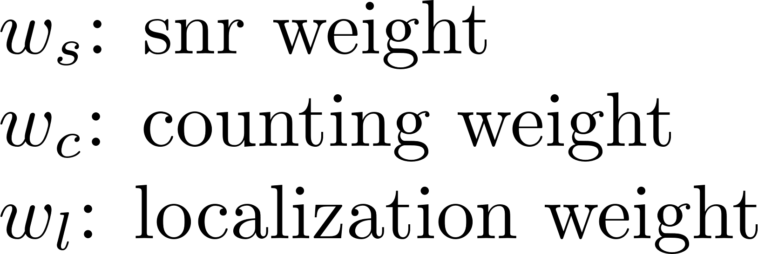
Challenge evaluation
Number of targets
Sector of each target
Sector | #people
A | 1
B | 0
C | 1
.txt
Final evaluation:
Challenge evaluation
Sector | #people
A | 1
B | 0
C | 0
.txt
Number of targets
Sector of each target
Provided

Slide 38
Guest Researcher position at NIST
Prize: guest researcher position at NIST

Slide 39
Communicate and sense at 60GHz
Shed light on passive sensing and localization performance re-using current 5G infrastructure.
Quantify the impact of novel AI/ML techniques with respect to conventional signal processing.
Provide future directions to IEEE standardization activities.

Slide 40
References
A collection of open-source tools to simulate IEEE 802.11ad/ay WLAN networks in network simulator ns-3. https://github.com/wigig-tools
Q-D simulation & Modeling framework for sensing https://mentor.ieee.org/802.11/dcn/21/11-21-0746-01-00bf-q-d-simulation-modeling-framework-for-sensing.pptx
A preliminary channel model using raytracing to detect human presence https://mentor.ieee.org/802.11/dcn/21/11-21-0747-01-00bf-a-preliminary-channel-model-using-raytracing-to-detect-human-presence.pptx

Slide 41
Questions?
steve.blandino@nist.gov

